Slide 1
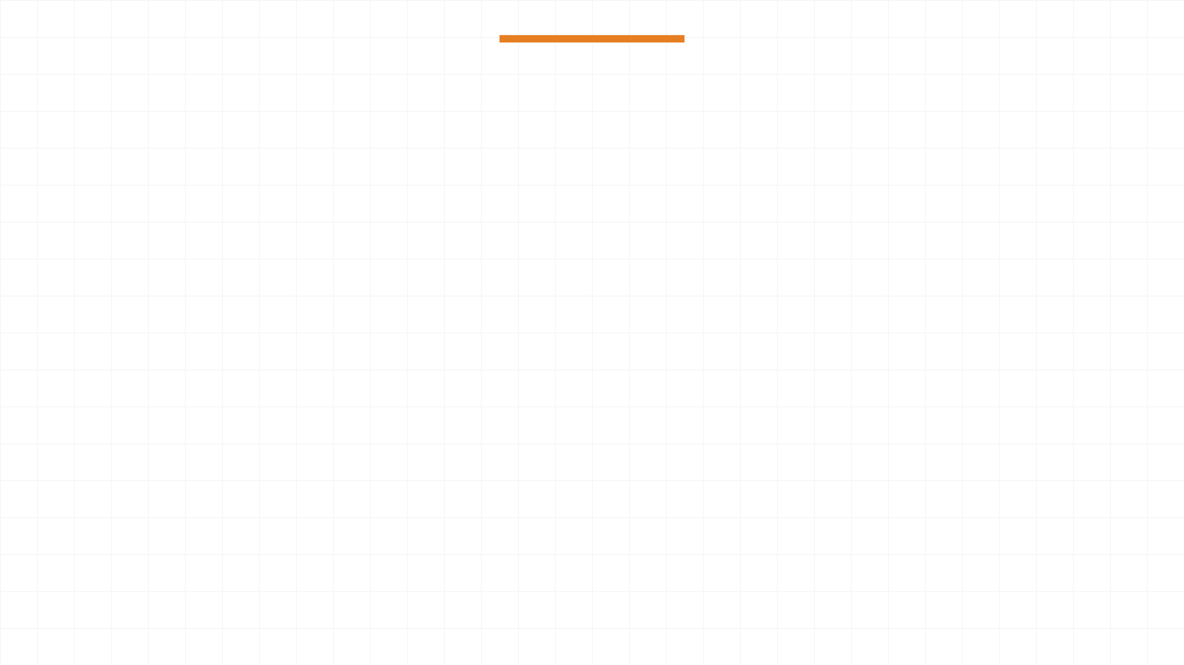
Design and Analysis of a VFFS Auger Filler Machine
From Theoretical Design to Structural Validation
Preper: Hassan Moqbel Morshed
February 2026

Slide 2

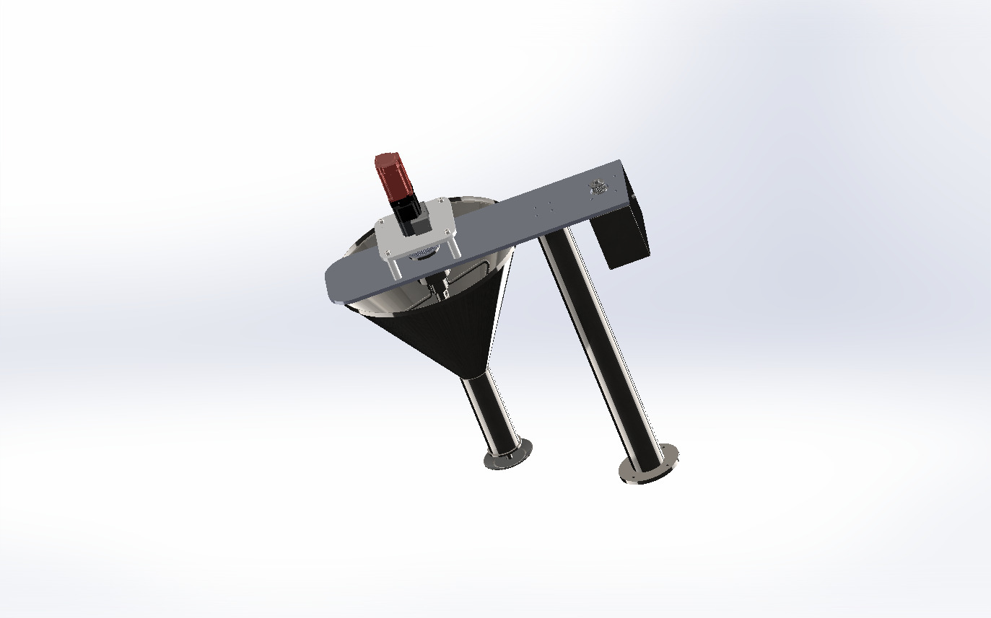
Introduction & Project Overview
Definition
VFFS (Vertical Form Fill Seal) is an automated packaging system used for powders and granules.
Objective
To design a high-precision Auger Filler system specifically for corrosive materials like salt.
Key Features
High dosing accuracy with Servo-driven precision.
Corrosion-resistant materials (AISI 316L/304) for food safety.
Advanced control system using ESP32 with FreeRTOS.
Mass flow optimization for high-density materials (1300 kg/m³).

Slide 3
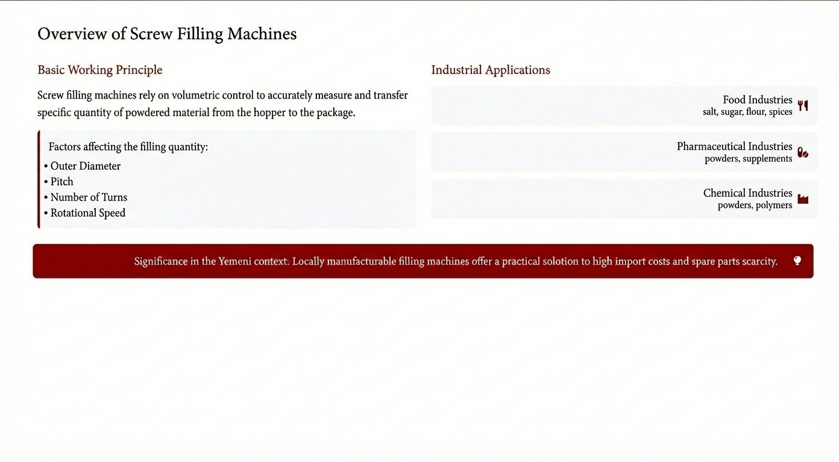

Slide 4
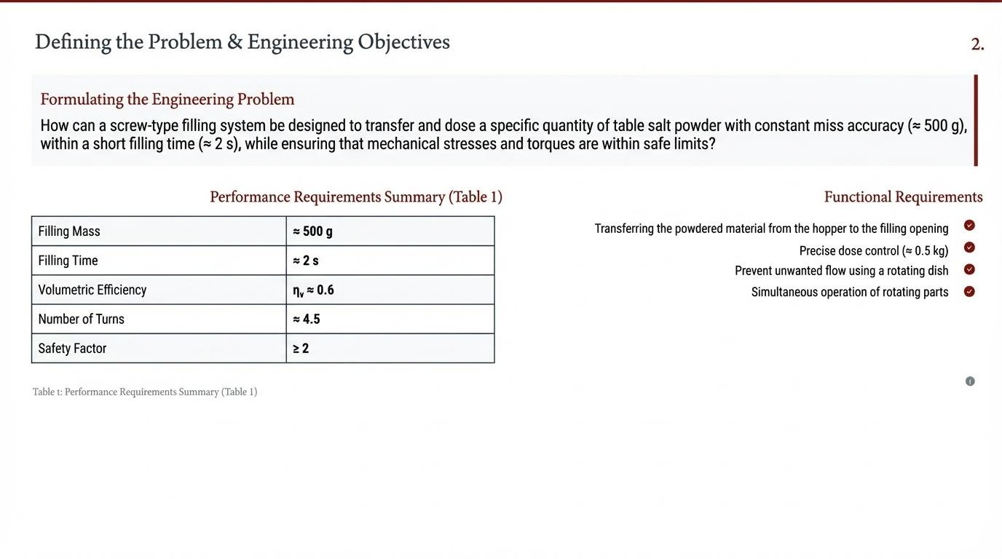

Slide 5
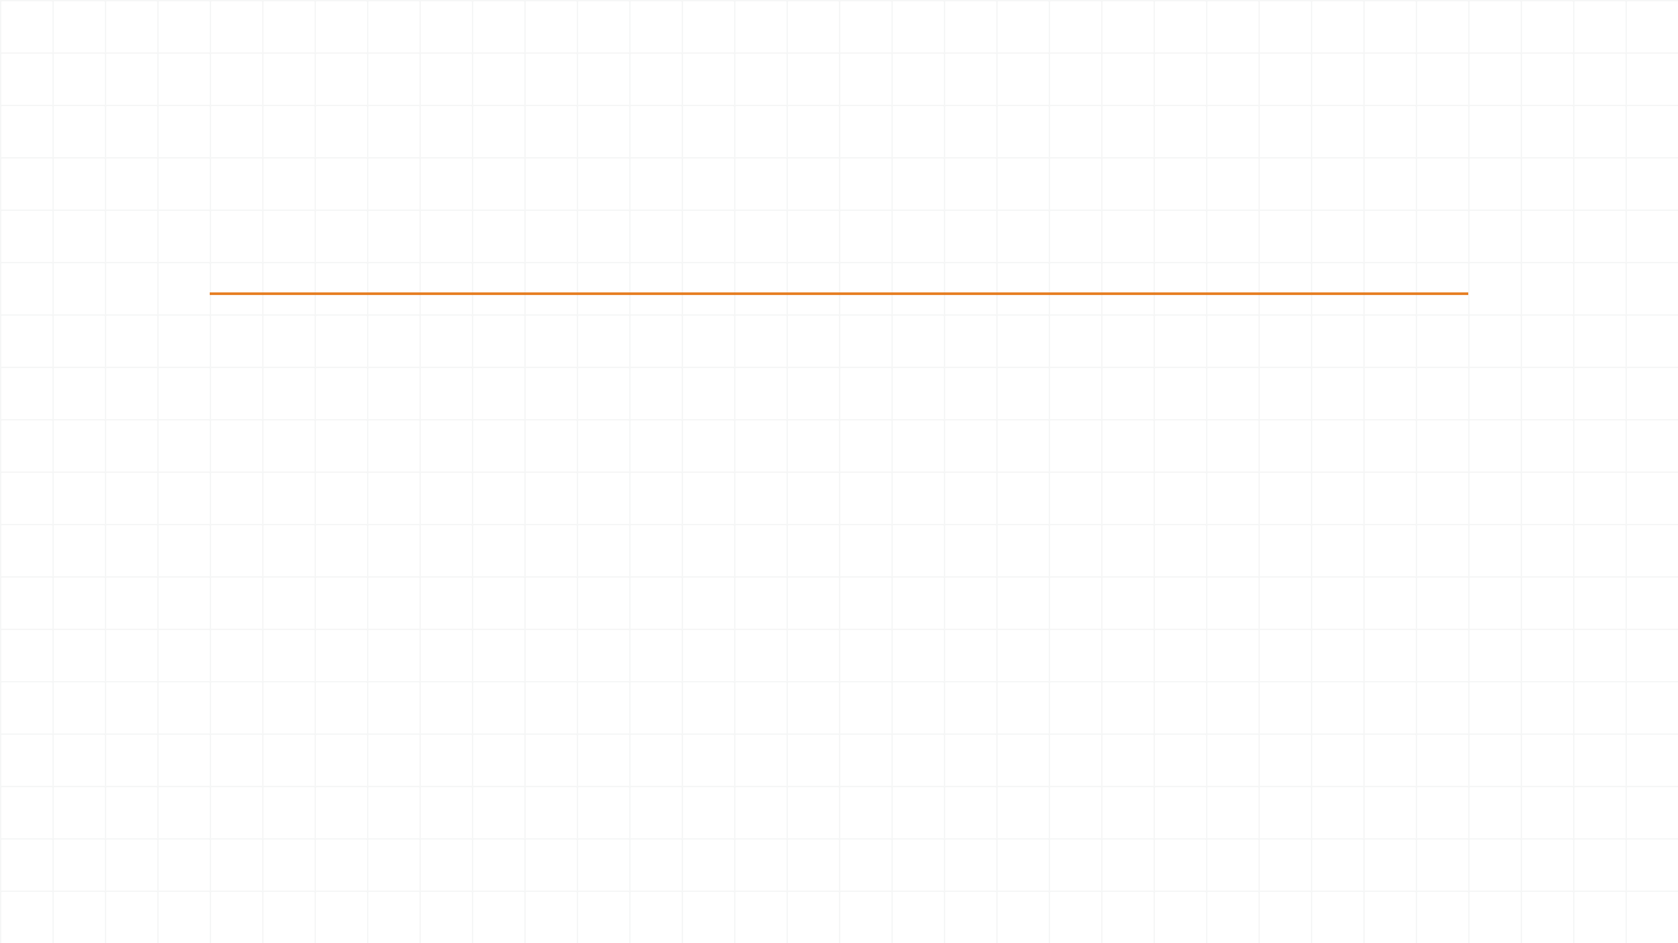
Design Methodology
01
02
03
04
05
Research
Modeling
CAD Design
Analysis
Control
Analyzing material properties and market requirements.
Modeling volumetric flow and torque needs.
3D modeling of Auger, Shaft, Hopper in SolidWorks.
FEA and DEM simulations for validation.
Control logic for Servo and Pneumatic integration.

Slide 6

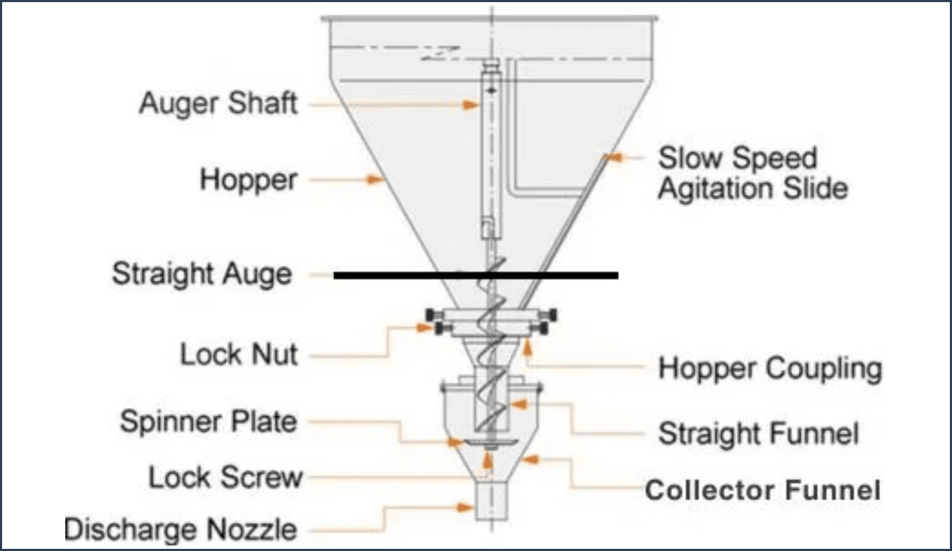
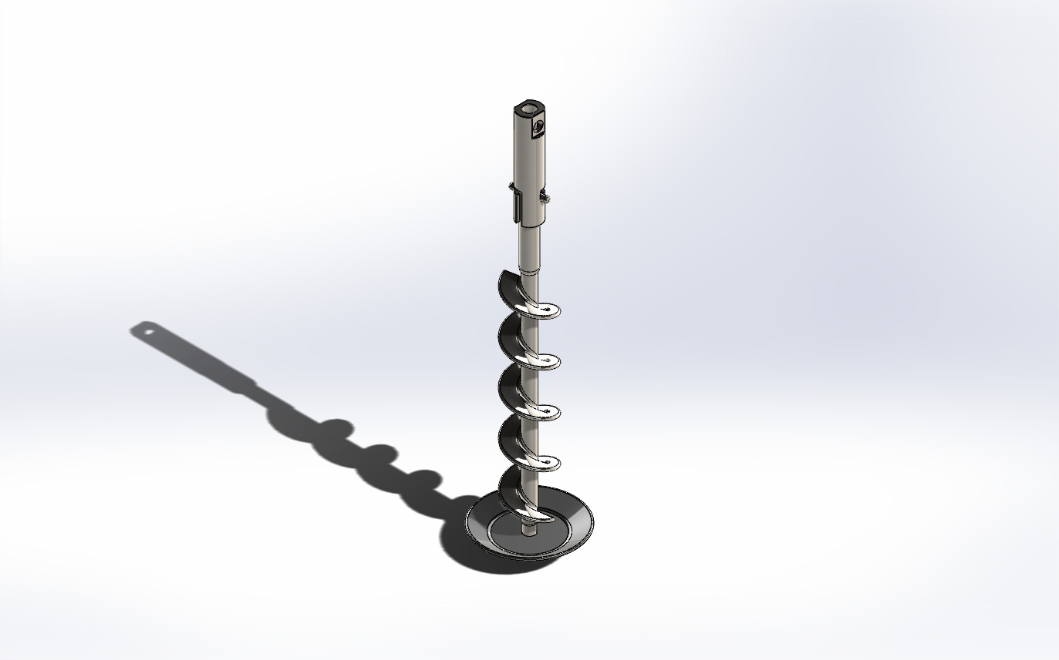
Mechanical Design: Auger & Shaft
Auger Specifications
Effective Length: 240 mm (Optimized for precision).
Flight Configuration: 4 full flights for consistent dosing.
Material: AISI 316L Stainless Steel (Food Grade).
Figure 1: Auger Filler Assembly Diagram
Surface Finish: Electropolished to prevent material sticking.
Shaft Design
Material: AISI 304/316L for high torsional strength.
Connection: J-slot and Cross-pin for secure torque transfer.
Maintenance: Tool-less disassembly for rapid cleaning.
Alignment: Precision-machined for zero-vibration rotation.
Figure 2: Dosing Screw Detail and Flow Path

Slide 7
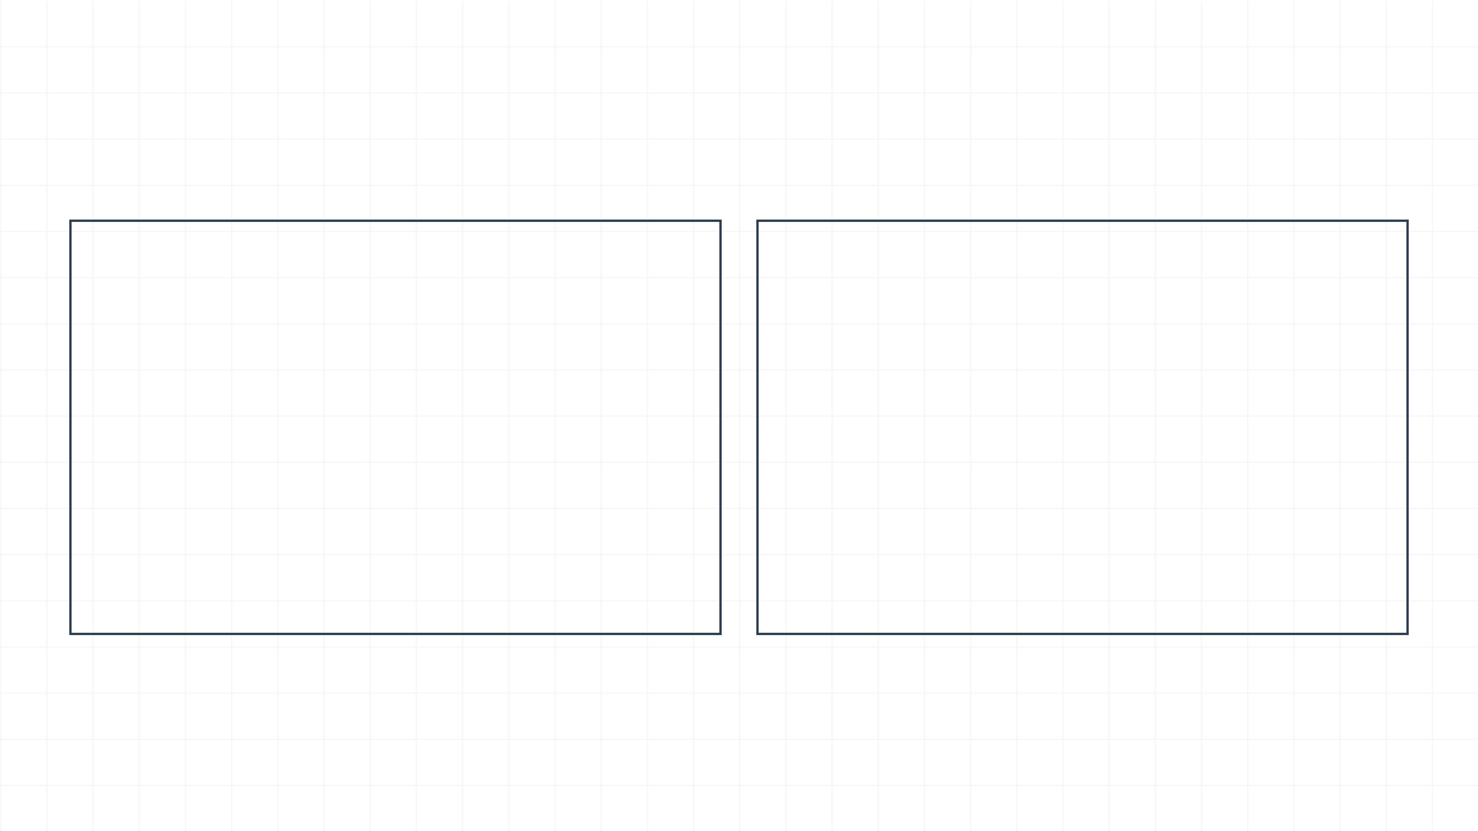
Volumetric & Mass Calculations
Volume per Revolution
Mass Calculation
V_{rev} = π/4 (D² - d²) × P
Mass = V_{rev} × ρ × η
D
Outer Diameter of Auger
ρ
Material Density (1300 kg/m³)
d
Inner (Shaft) Diameter
P
Pitch of the Auger Flight
η
Volumetric Efficiency (≈ 0.95)
Adjusted for material behavior and filling efficiency.
Determines the theoretical displacement per cycle.

Slide 8
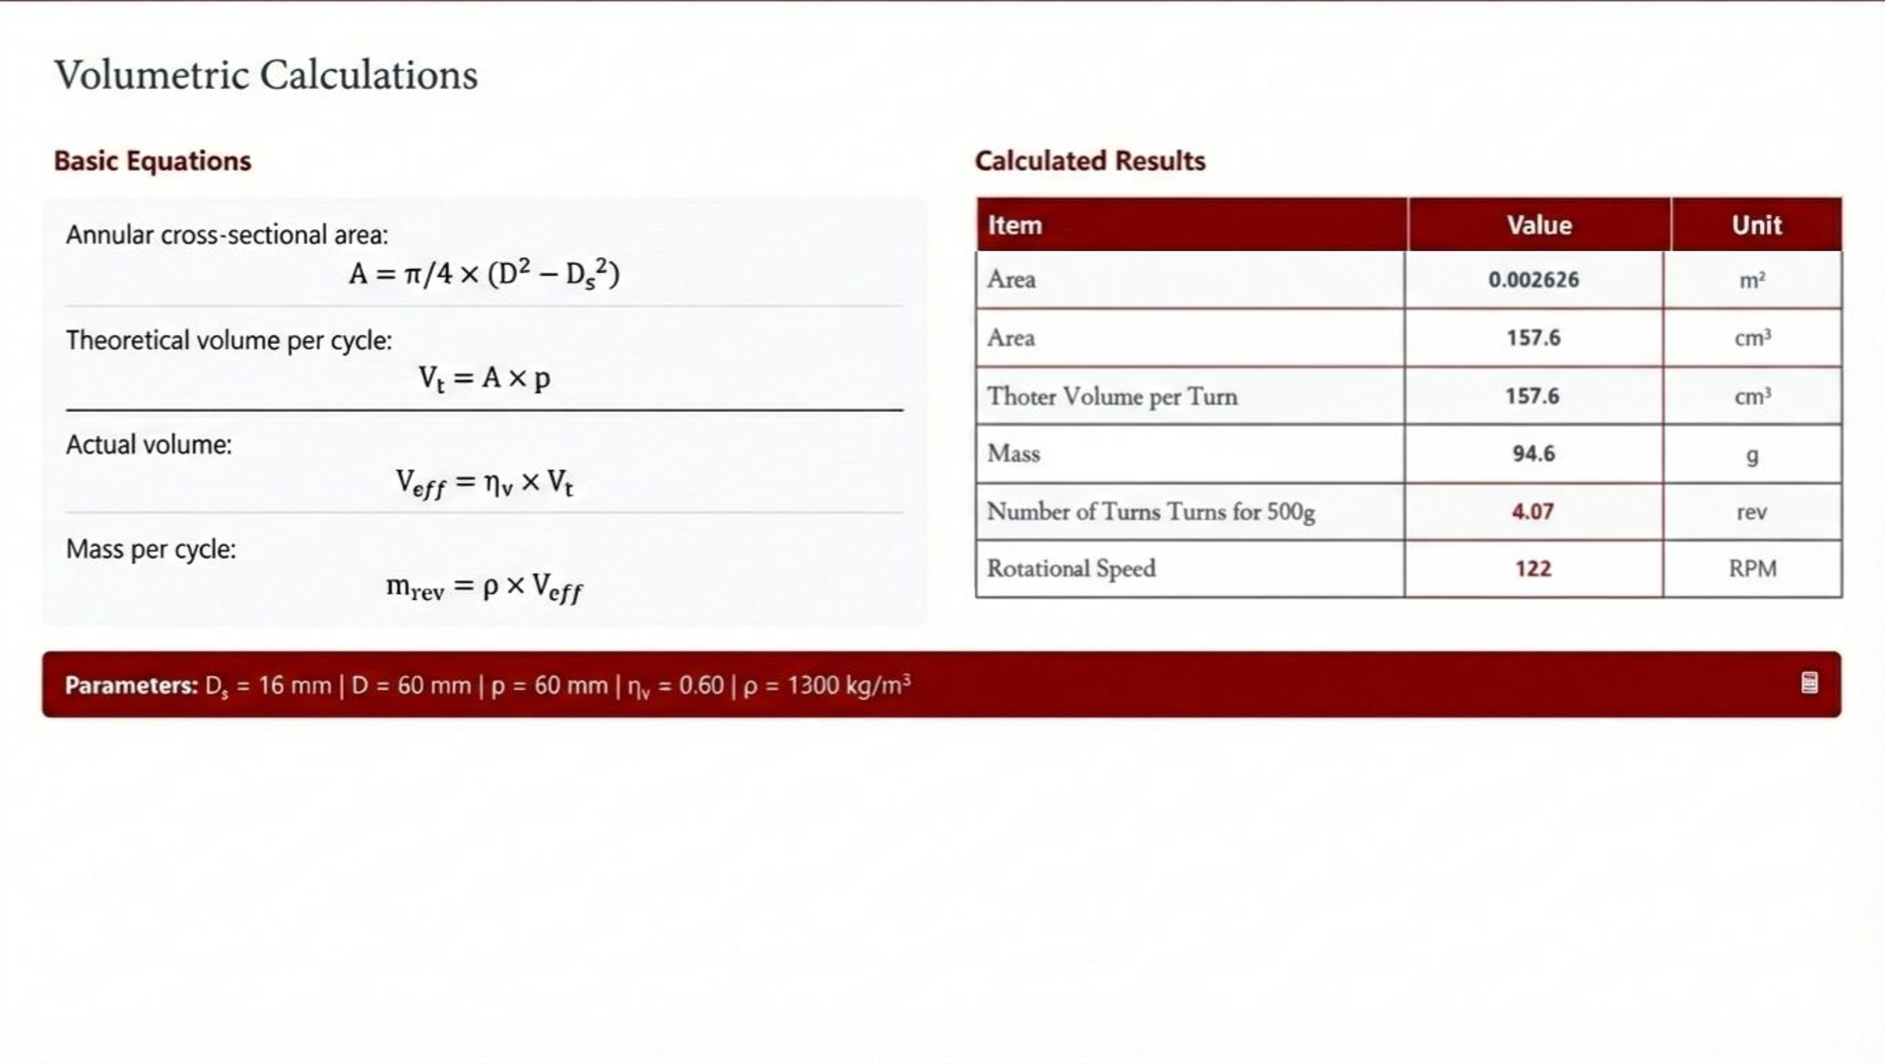

Slide 9
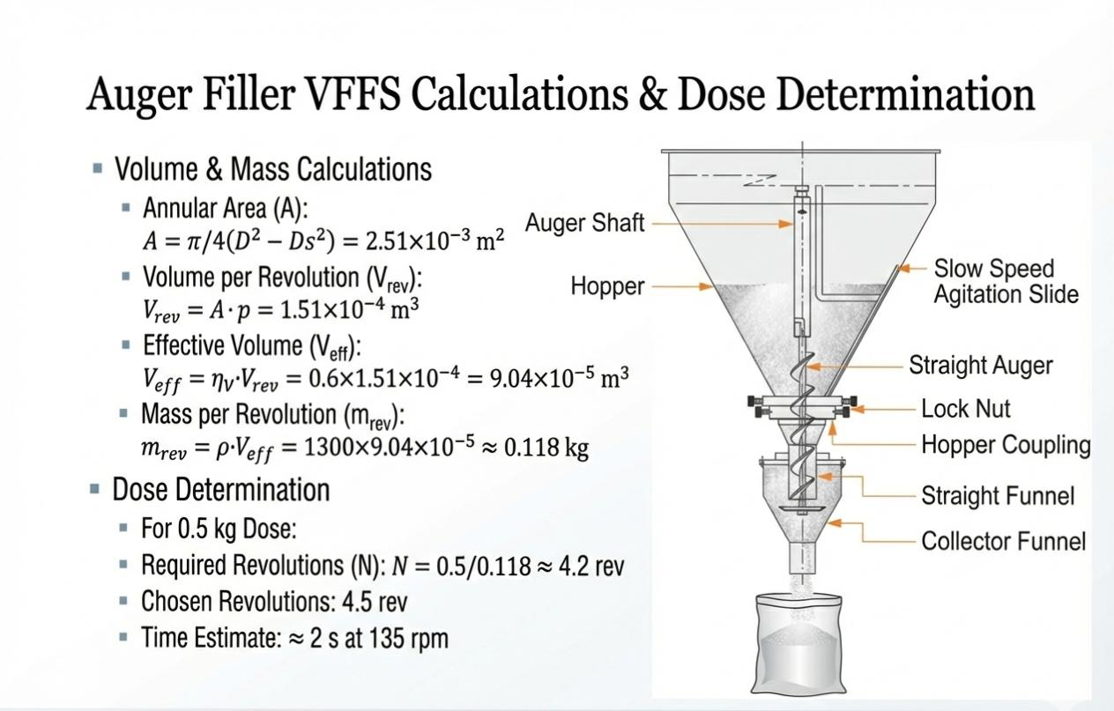

Slide 10

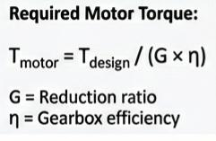
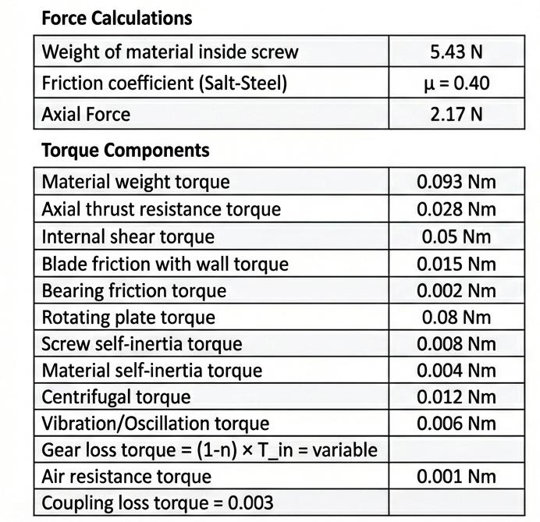
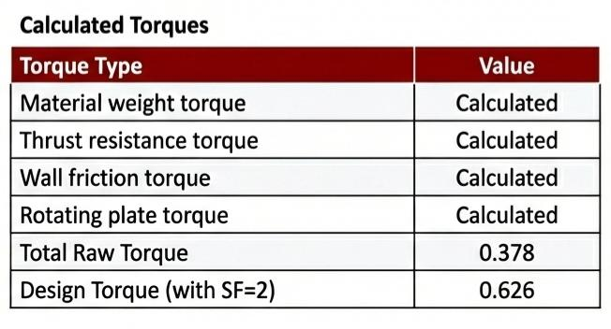
Motor Selection
Torque & Power Analysis
Servo Motor: Panasonic MSMF042L1U1.
Rated Torque: 1.27 N.m.
Torque Requirements
Gearbox Specifications
Calculated Load Torque: ~0.25 N.m (at motor shaft).
Type & Ratio: High-Precision Planetary, 1:20
Auger Operating Torque: 4.5 N.m (worst-case).
Safety Factor: 2.5x (ensures reliability).
System provides 19.98N.m at the Auger, exceeding requirements.

Slide 11
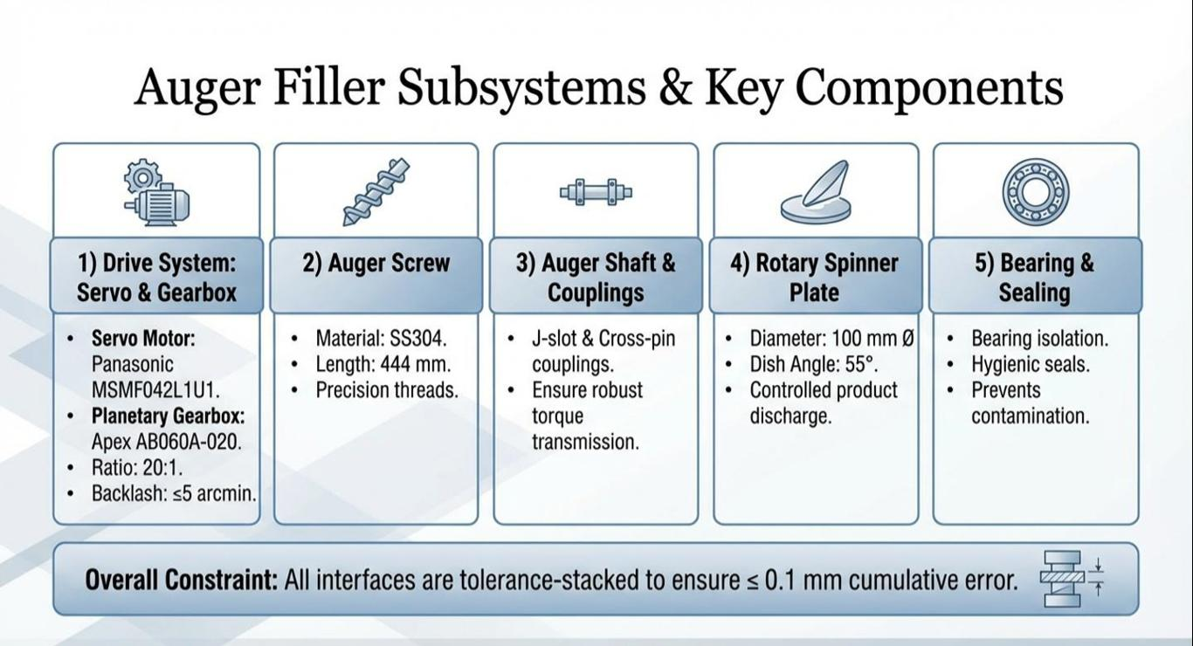

Slide 12
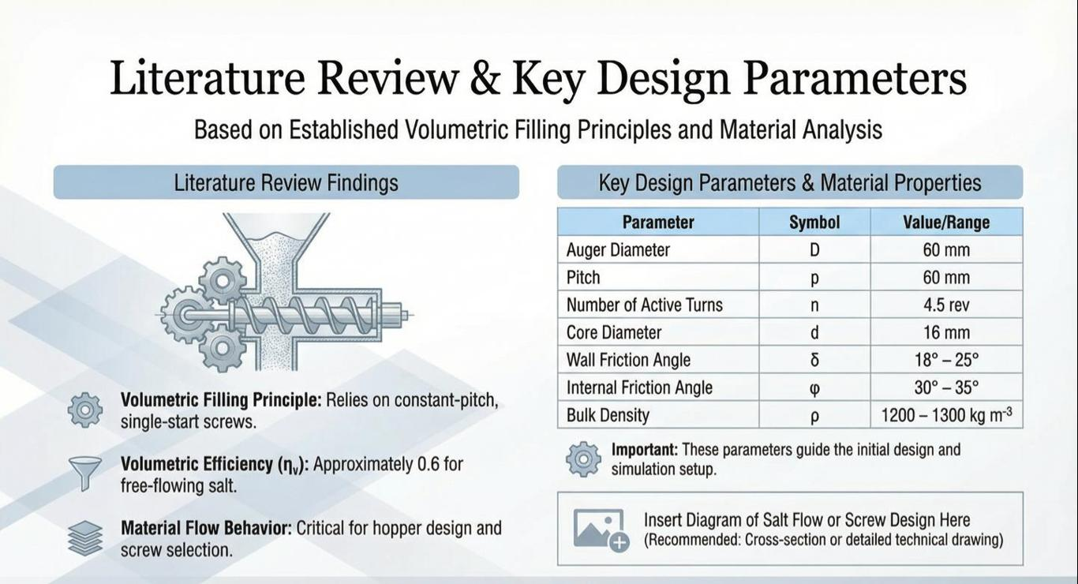
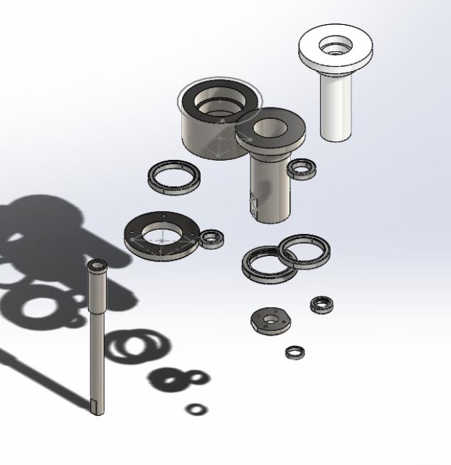
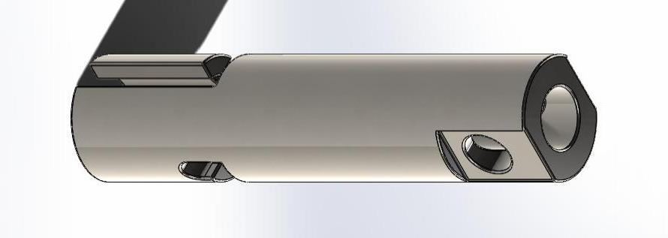
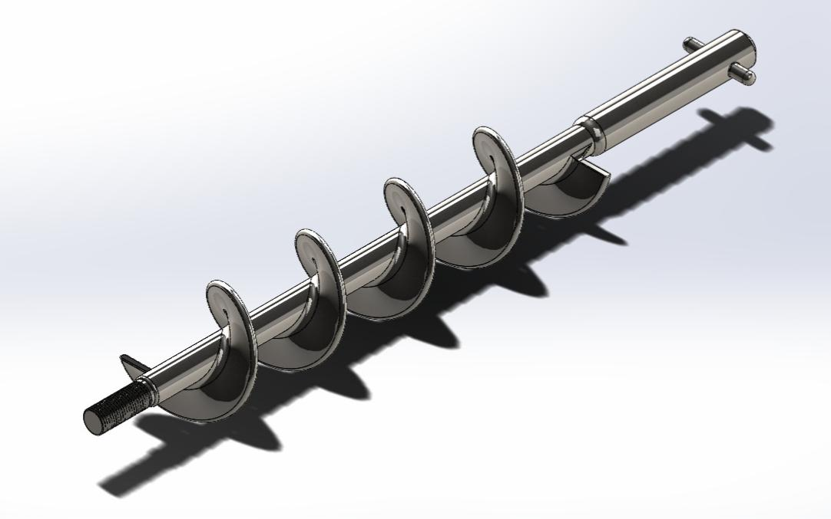

Slide 13
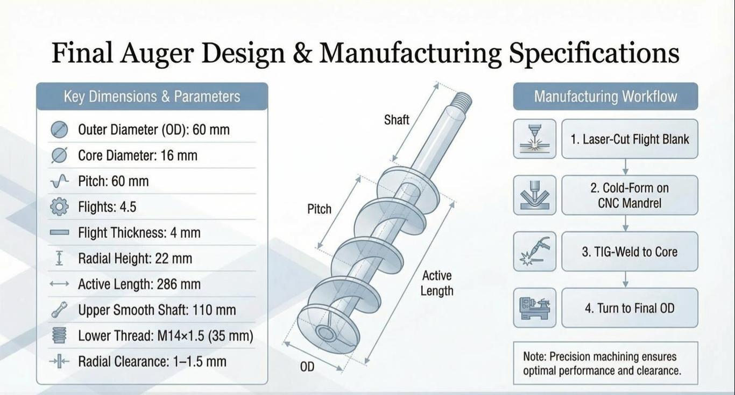

Slide 14
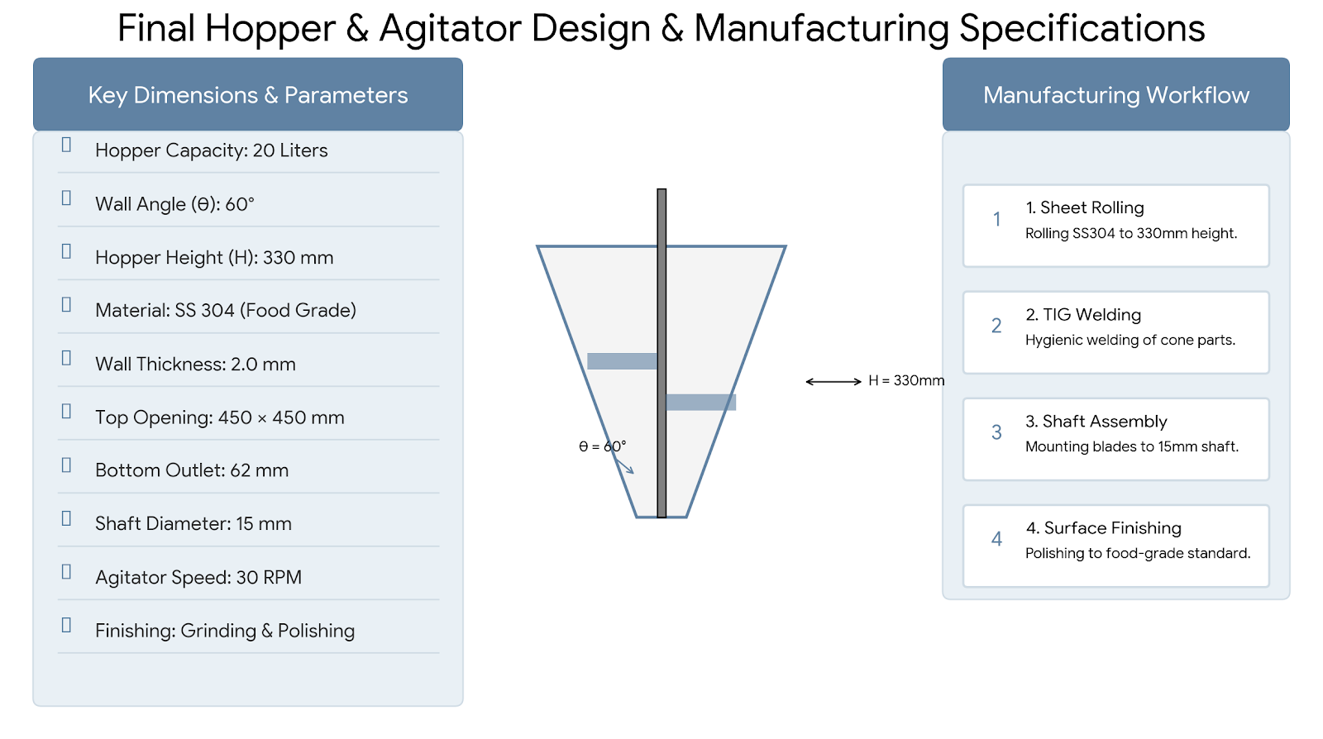

Slide 15
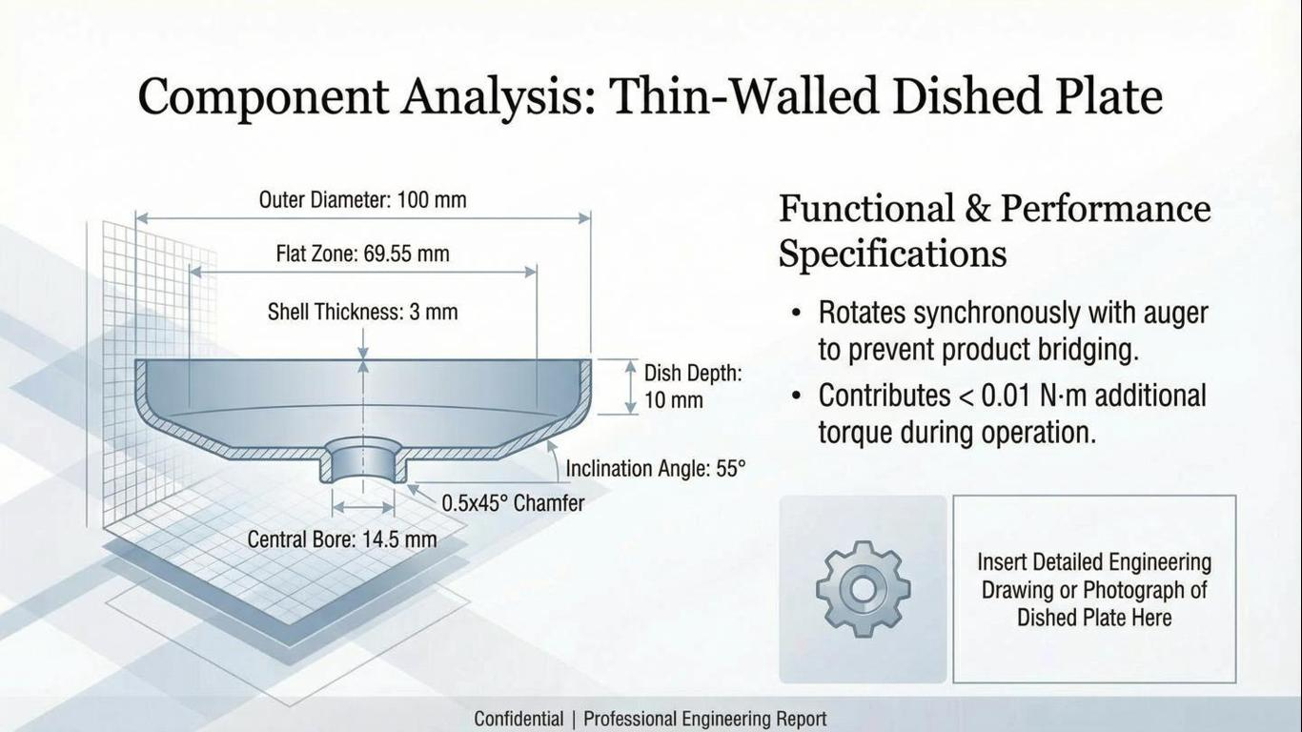
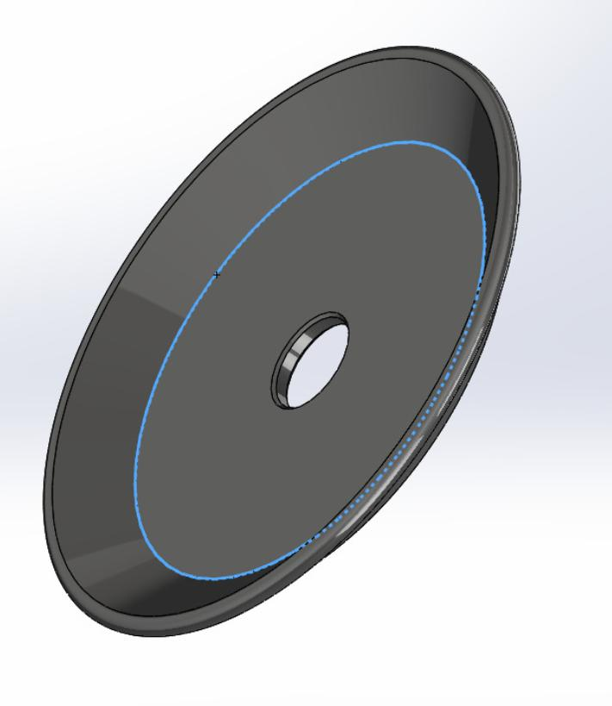

Slide 16
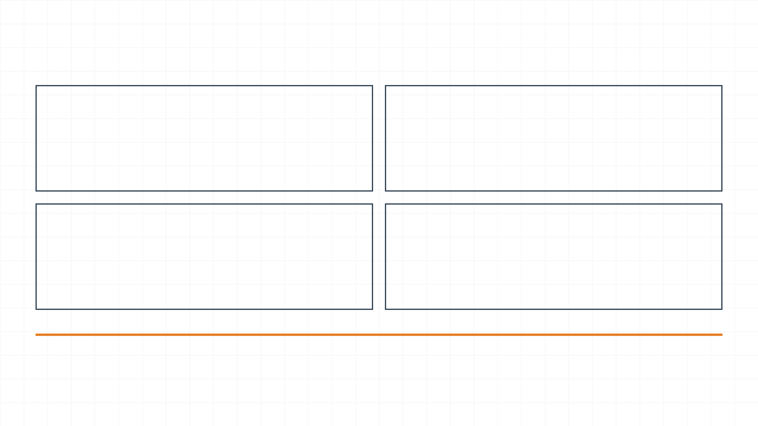
Structural Analysis: ANSYS Results
Max Von-Mises Stress
Total Deformation
136.8 MPa
0.095 mm
Significantly below the material yield strength of 206.8 MPa (AISI 304).
Minimal deflection ensures precise clearance between auger and tube.
Safety Factor
Analysis Type
1.51
Static Structural
Provides a robust margin for operational fatigue and peak loads.
Simulated under maximum torque and material pressure conditions.
Engineering Conclusion
The FEA results validate that the Auger design is structurally sound. All stresses remain within the elastic region of the material, and deformations are negligible, ensuring long-term reliability and dosing precision in industrial environments.

Slide 17
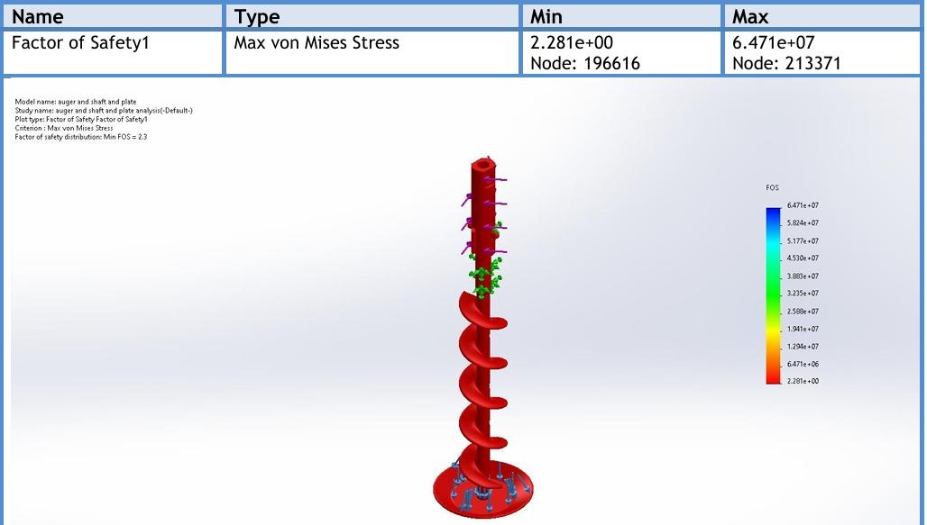
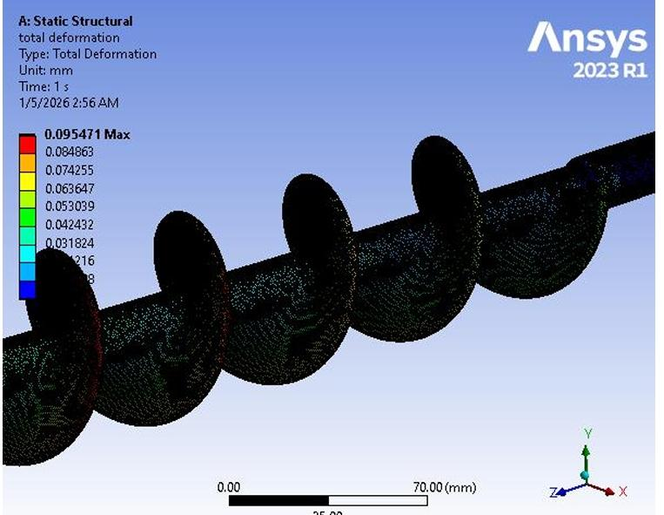
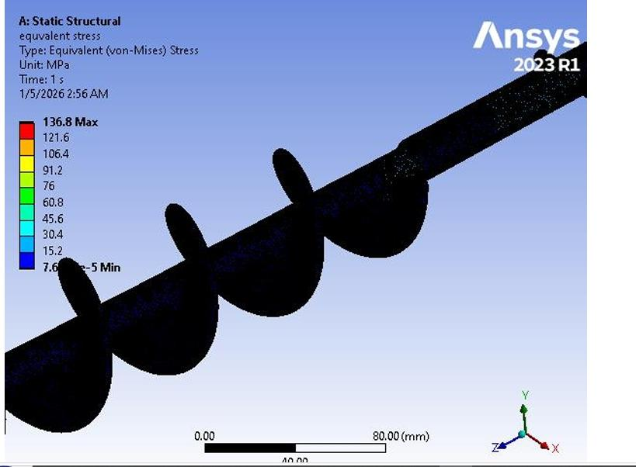
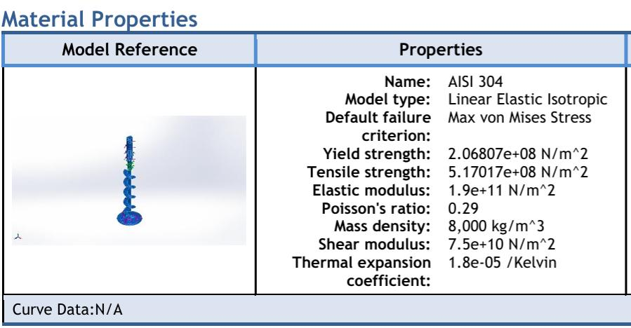
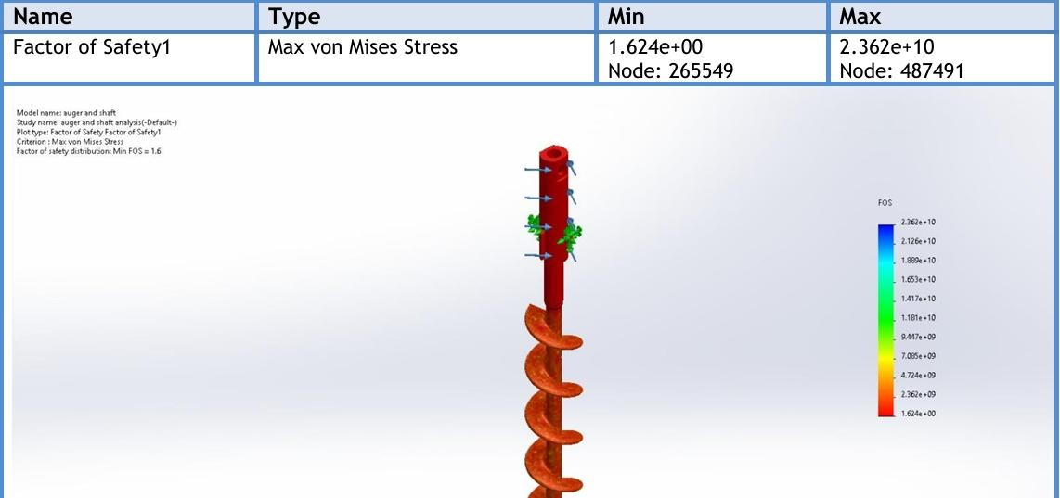

Slide 18
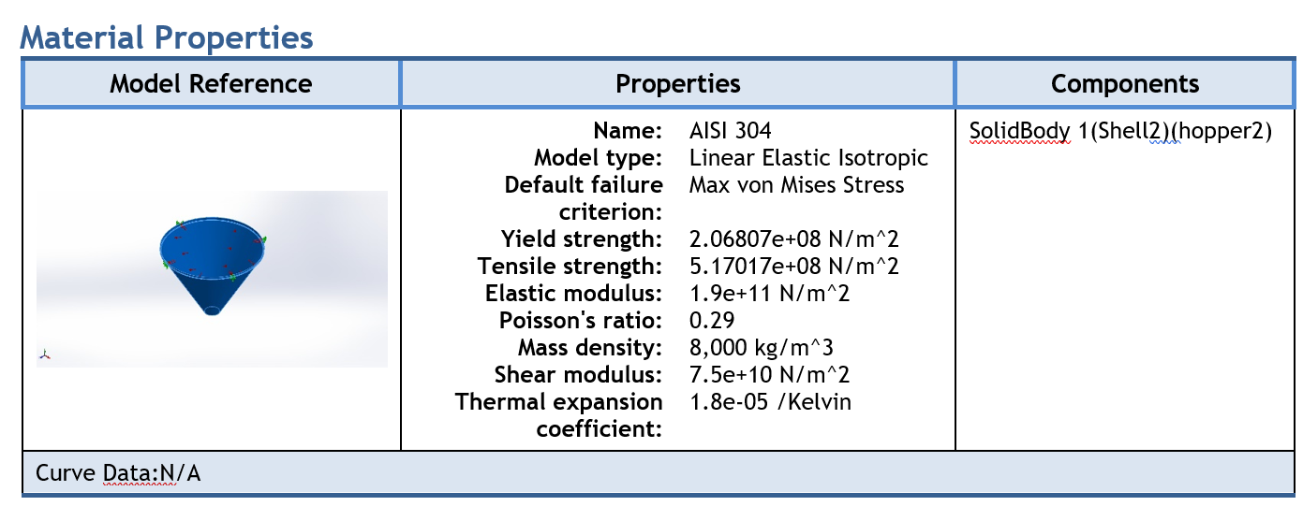
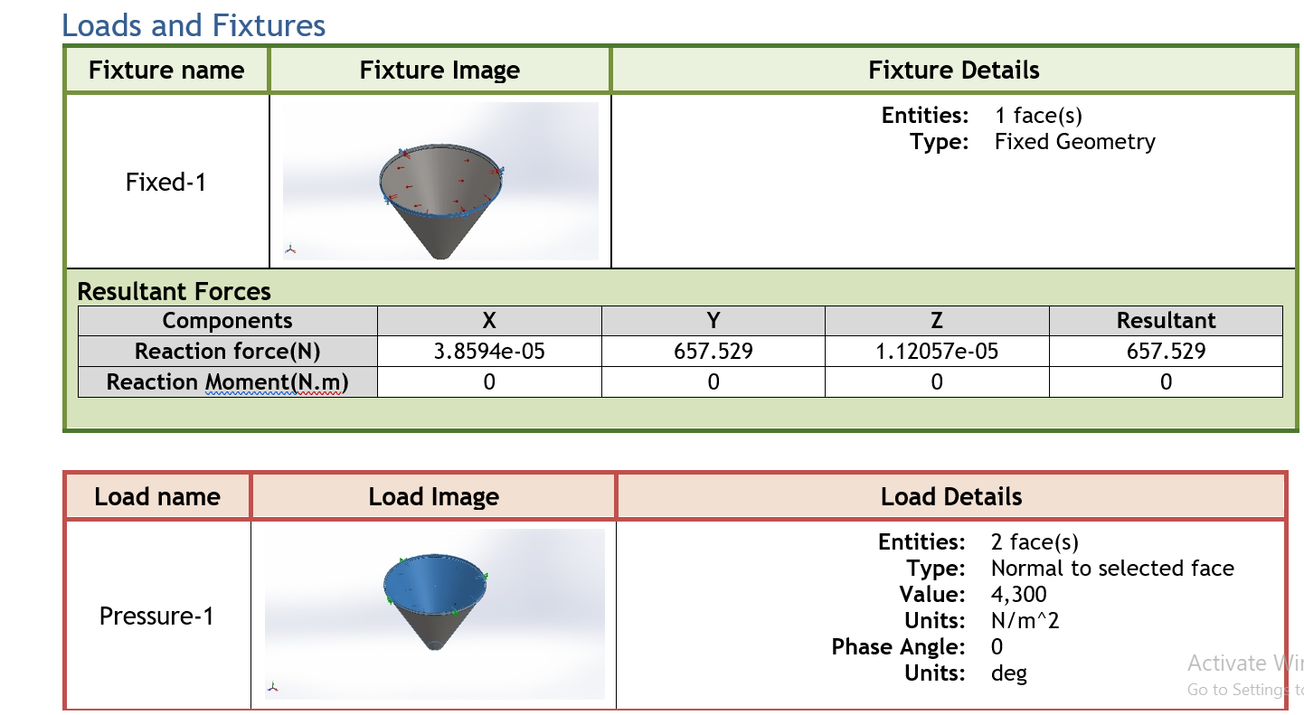
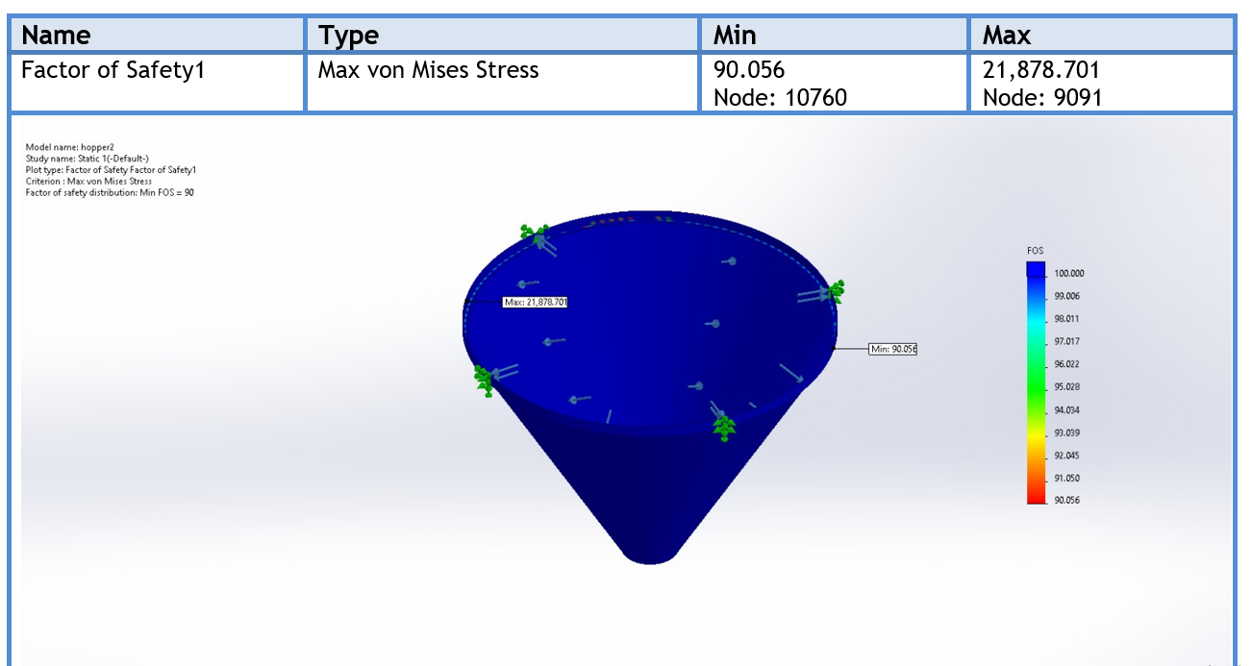

Slide 19
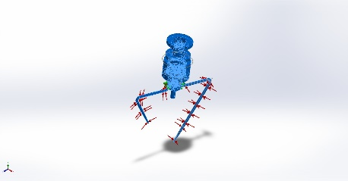
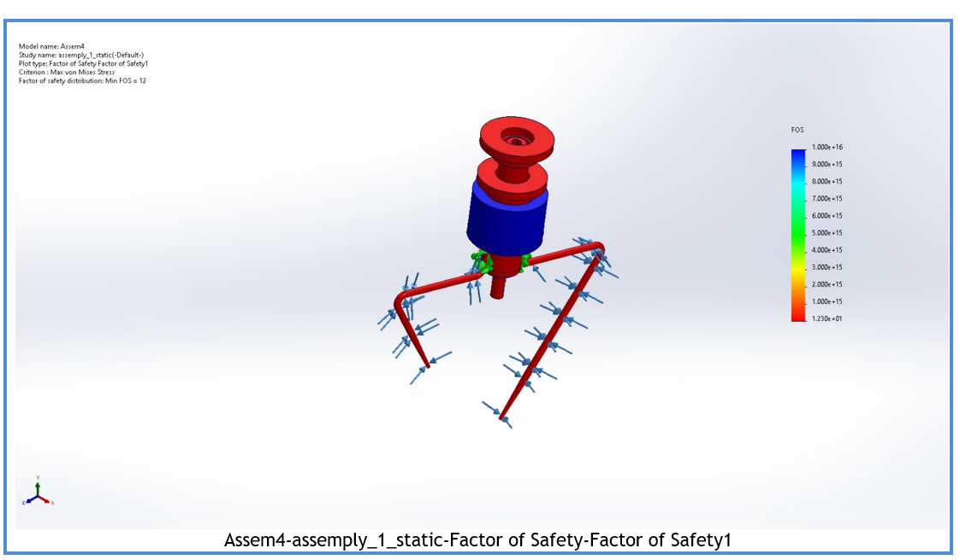
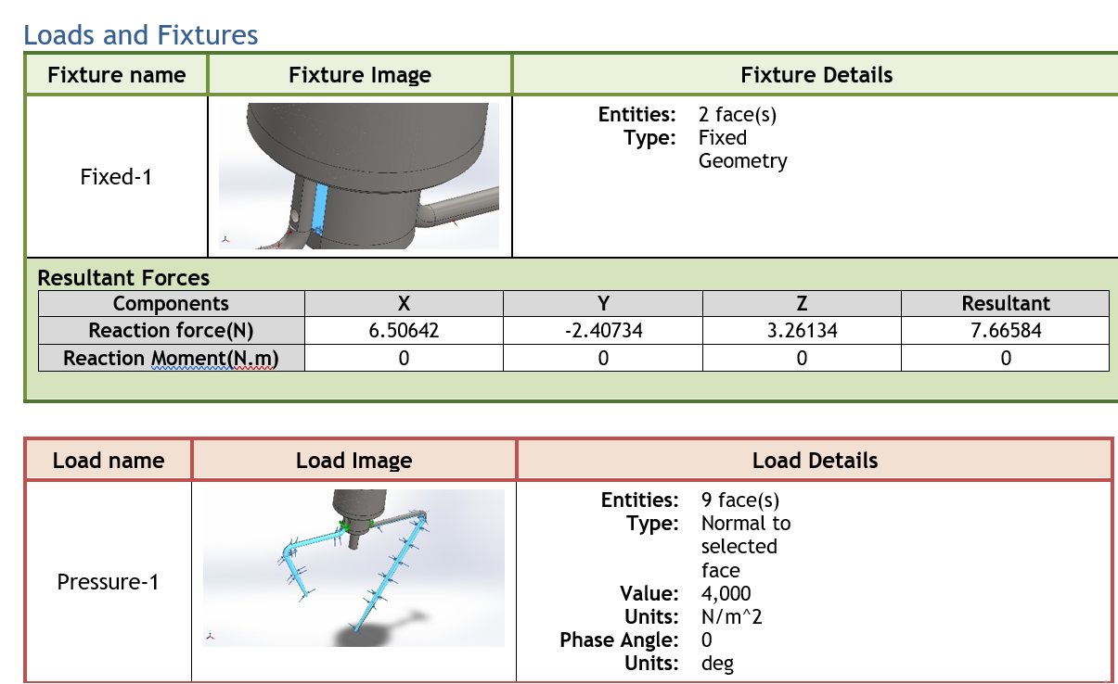

Slide 20
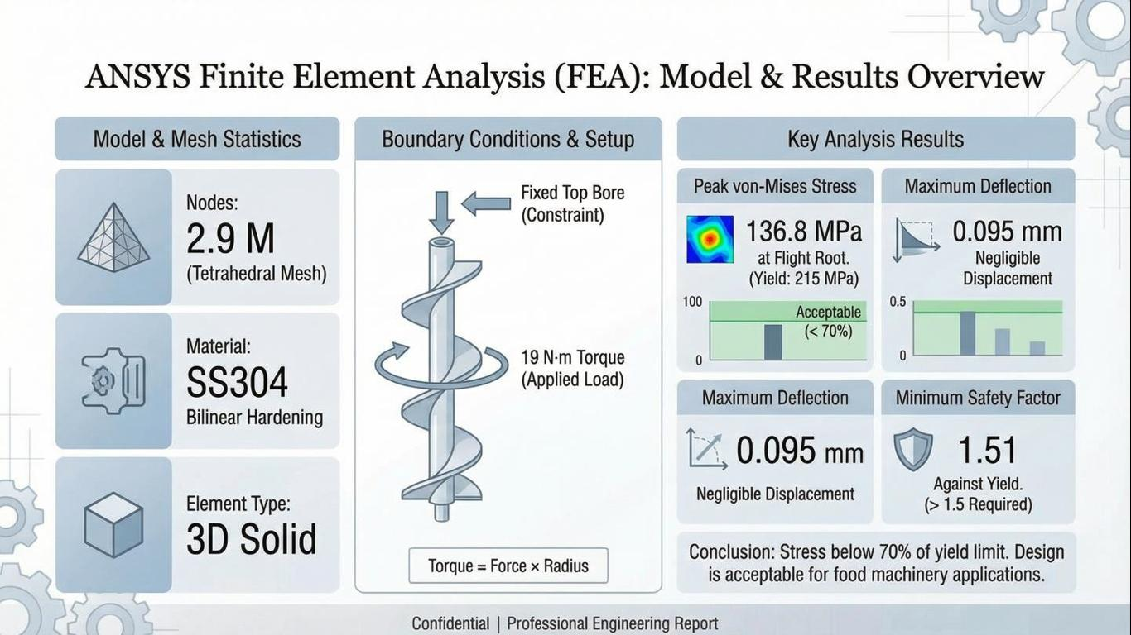
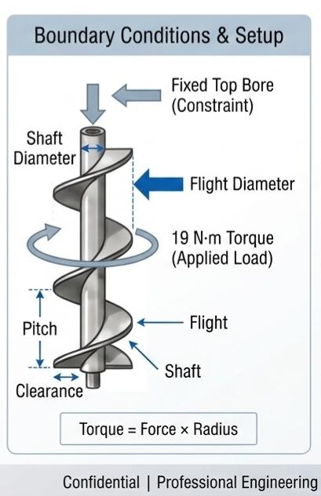

Slide 21
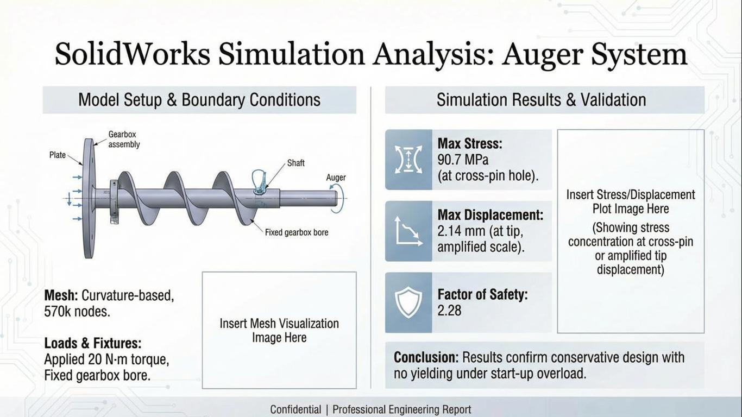
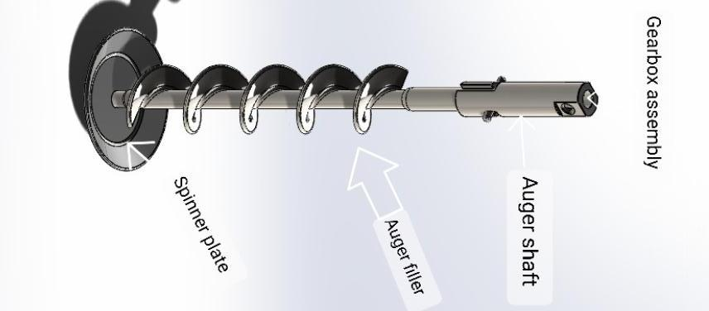
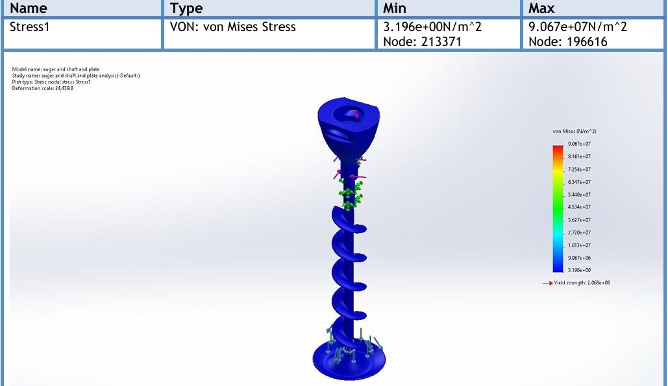
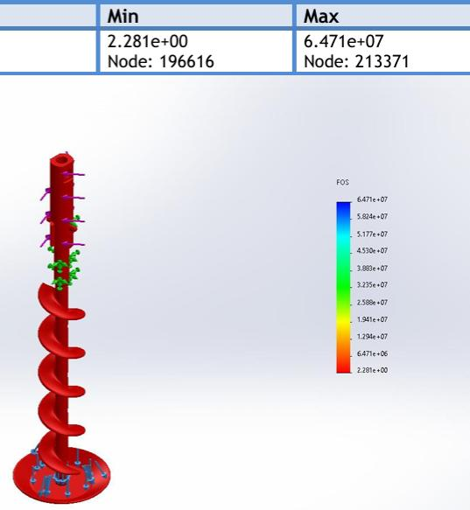

Slide 22
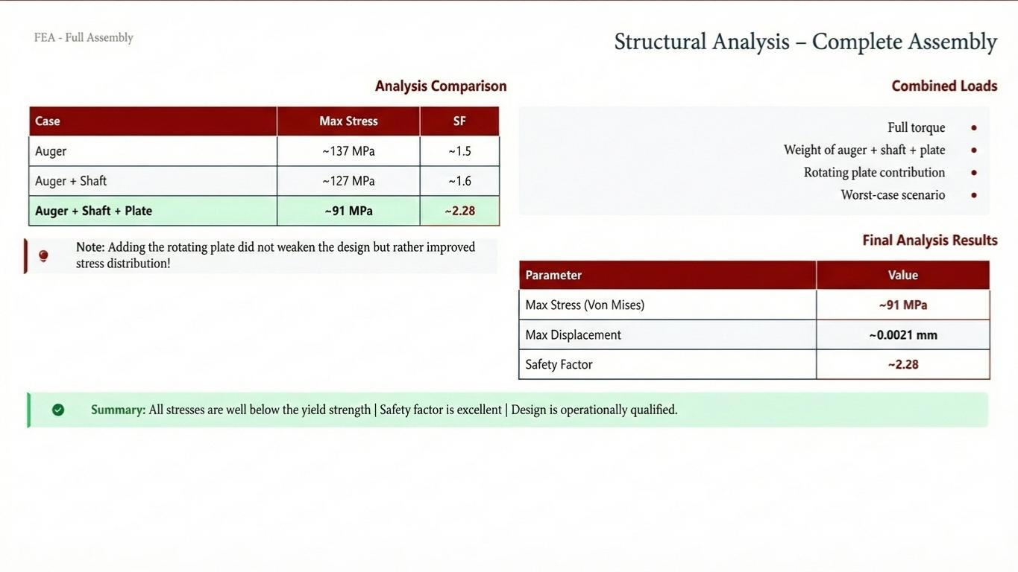
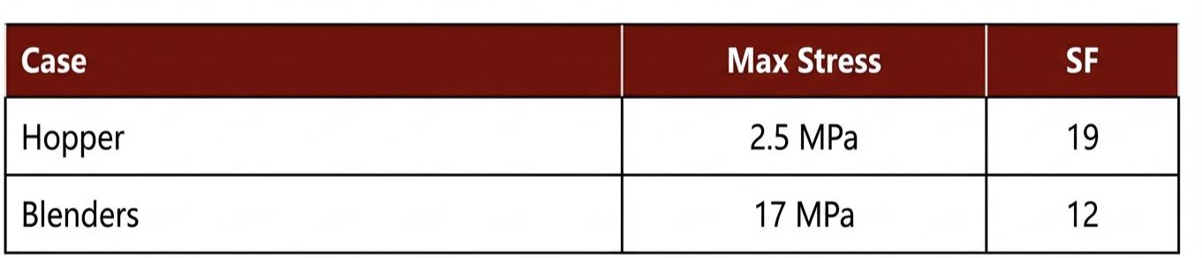

Slide 23
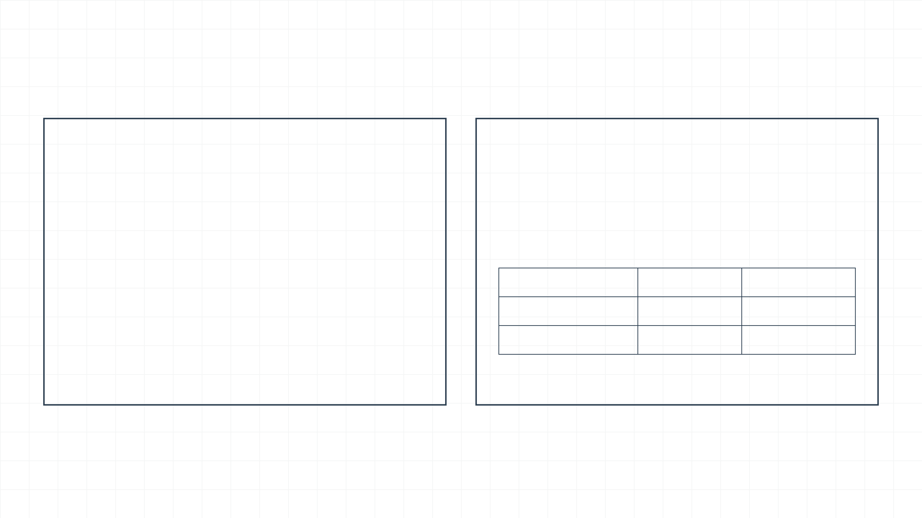
Integrated System Analysis: SolidWorks
Assembly Analysis
Cross-Validation
Verified torque transfer through the J-slot and Cross-pin connection.
Comparative study between ANSYS and SolidWorks Simulation results.
Max Assembly Stress: 127.3 MPa (within safe limits).
Metric
ANSYS
SolidWorks
Max Displacement: 0.0032 mm (ensures high rigidity).
Max Stress
136.8 MPa
127.3 MPa
Confirmed no interference between rotating components during operation.
Safety Factor
1.51
1.62
Max Deflection
0.095 mm
0.0032 mm
High correlation between solvers confirms model reliability.

Slide 24

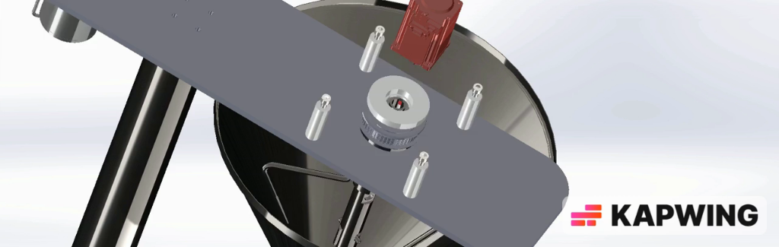

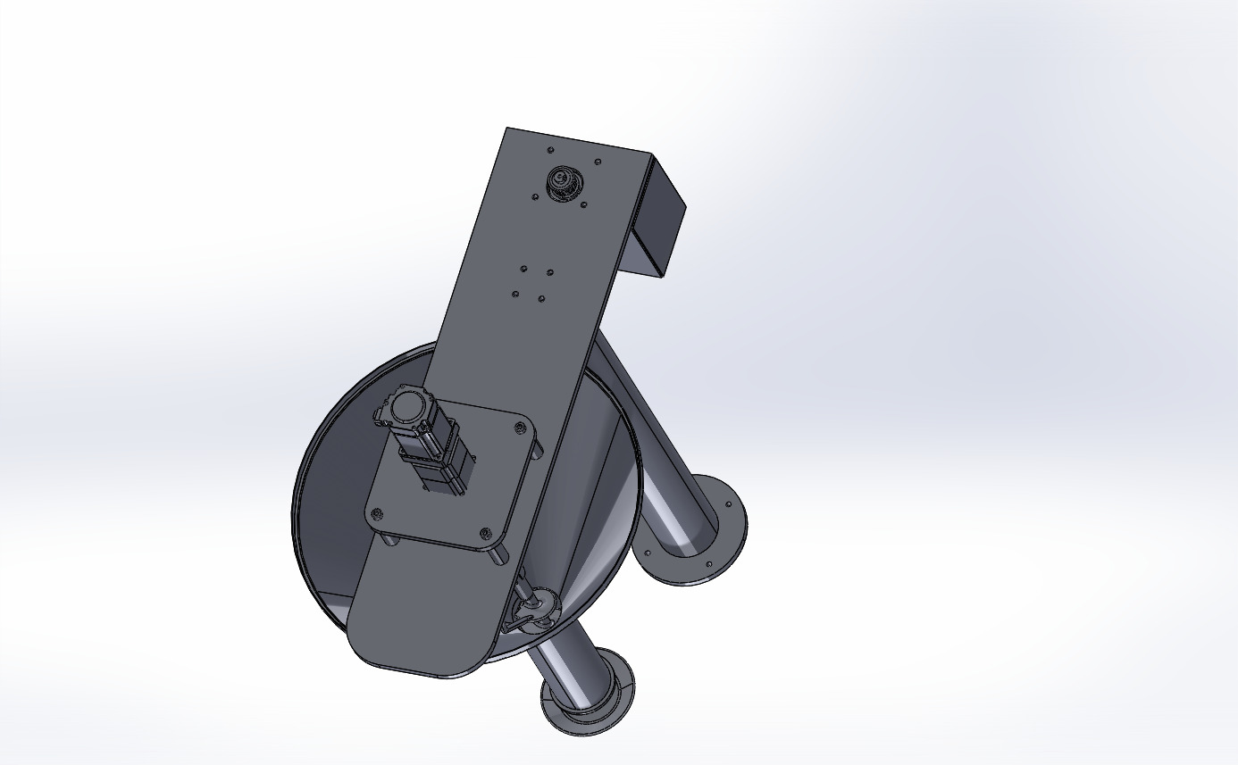
Operational Simulation & Motion Analysis
Simulation Objectives
Validation of dual-direction rotation (Auger vs. Agitator blades).
Analysis of material flow behavior and volumetric consistency.
Verification of dynamic stability under high-speed operation.
[ INSERT MOTION SIMULATION VIDEO HERE ]
Optimization of dosing cycle timing and material discharge.
Place the video showing the dual-direction rotation here.
Key Findings
Zero interference between rotating components.
Uniform material distribution within the dosing chamber.

Slide 25
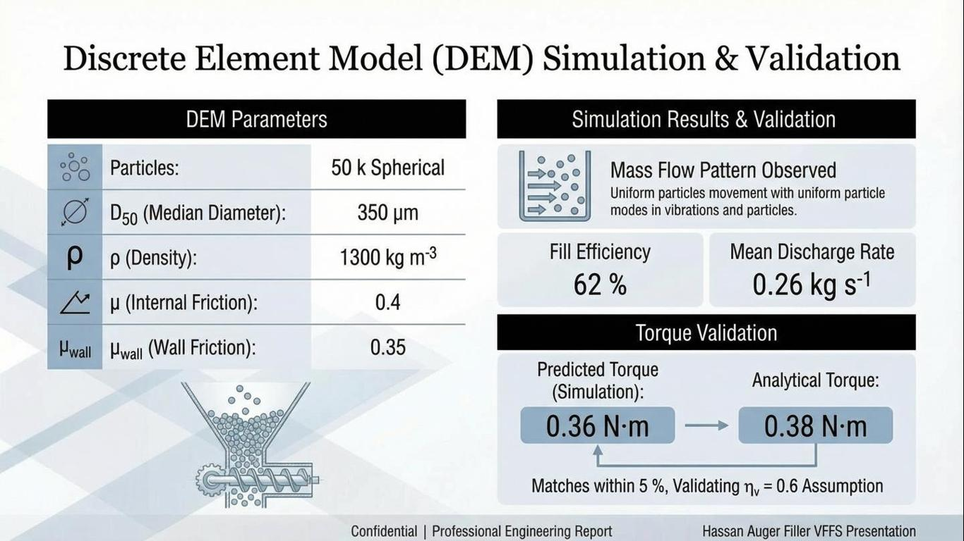
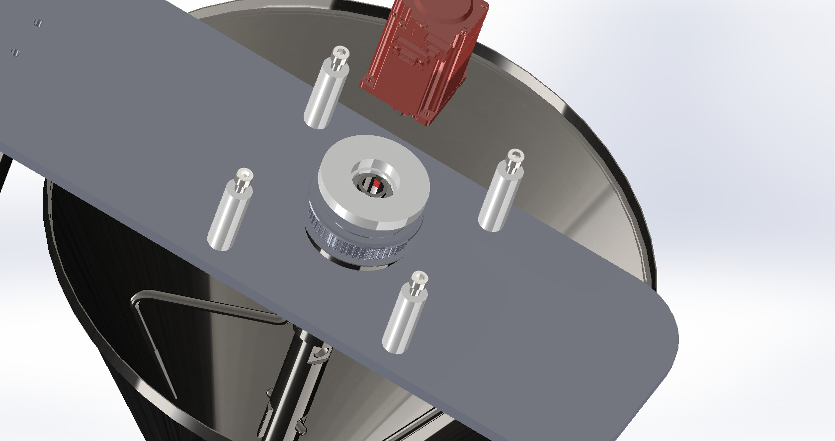

Slide 26
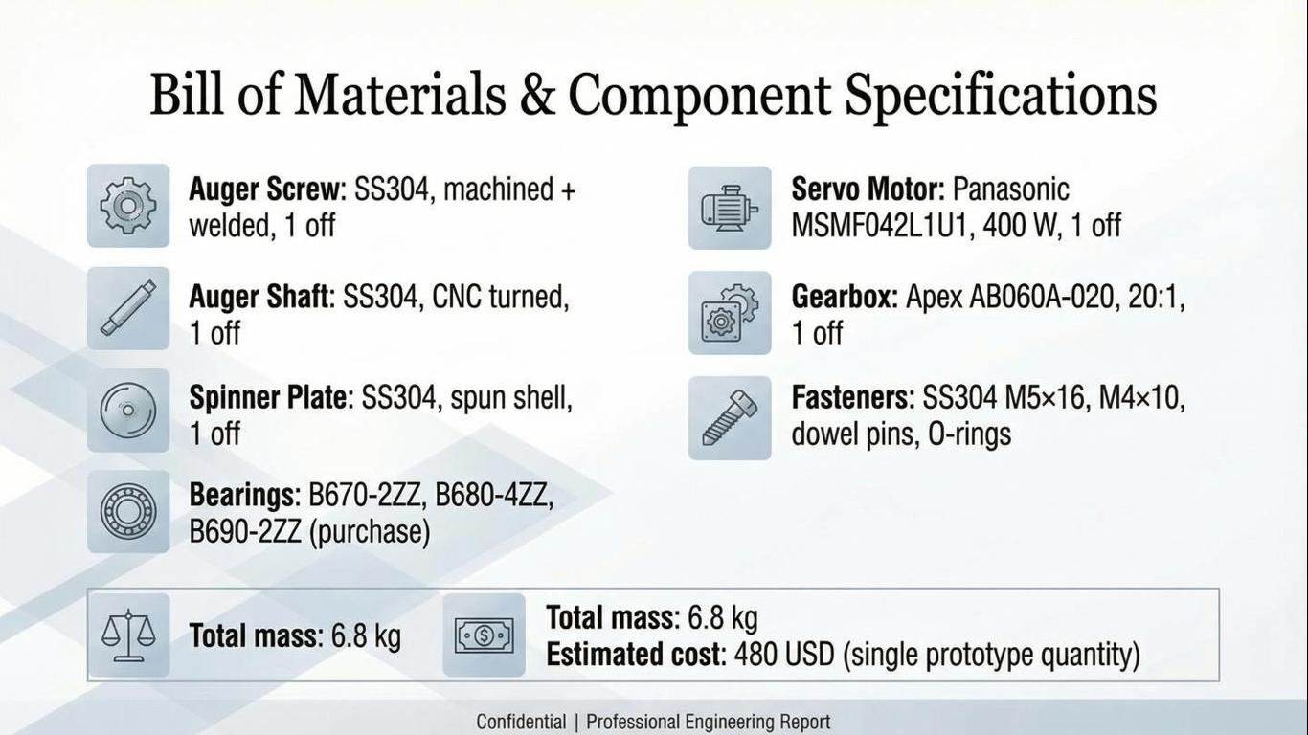

Slide 27
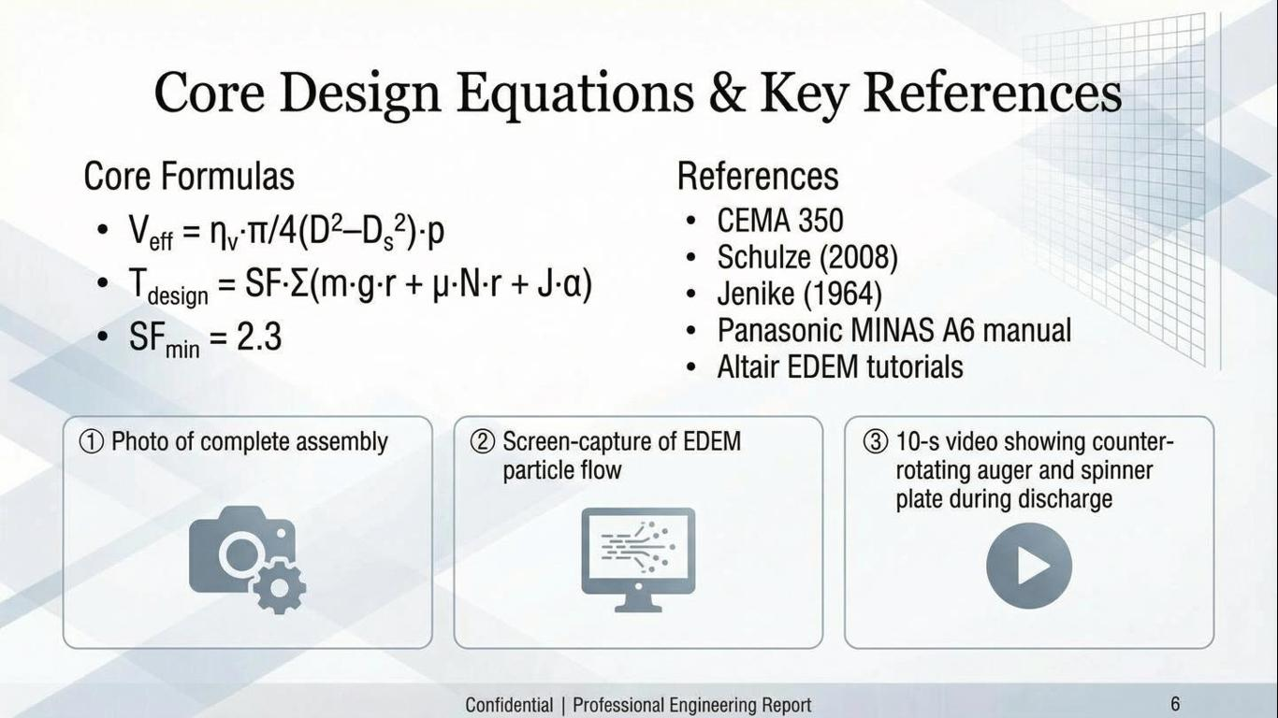
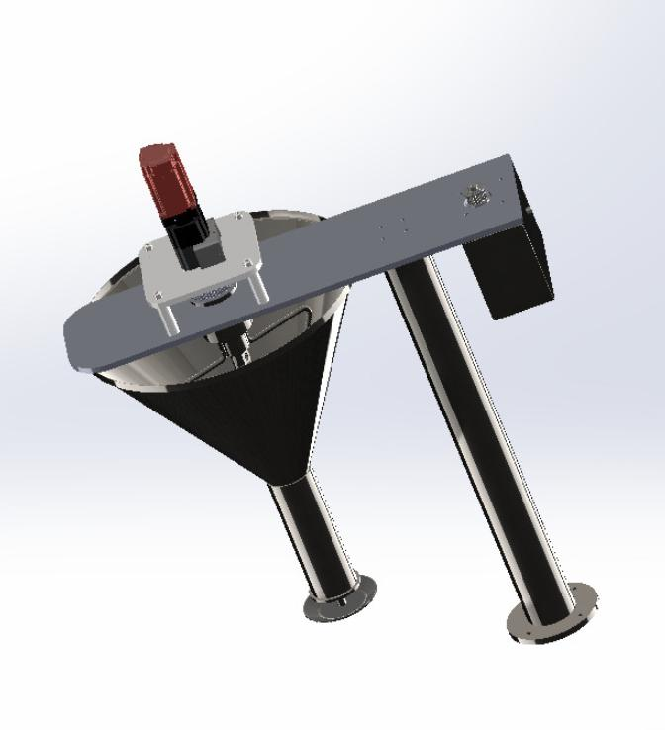


Slide 28

Bill of Materials (BOM) Summary
Category
Component
Specification / Material
Qty
Mechanical Components
Dosing
Auger Screw
AISI 316L Stainless Steel (Food Grade)
1
Structure
Main Shaft
AISI 304/316L - Precision Machined
1
Storage
Hopper Assembly
AISI 316L - 60° Wall Angle
1
Electrical & Control
Actuation
Servo Motor
Panasonic MSMF042L1U1 (400W, 1.27 N.m)
1
Transmission
Planetary Gearbox
Reduction Ratio 1:20 - High Precision
1
Control
Microcontroller
ESP32 DevKit V1 (Dual-Core)
1
Switching
Solid State Relay
SSR-40DA (40A, 3-32VDC Control)
2

Slide 29


Slide 30

Assess risks and limitations

Slide 31

Final results

Slide 32
Conclusion & Future Work
Project Achievements
Future Roadmap
Comprehensive structural validation using FEA (ANSYS & SolidWorks).
Physical prototyping and assembly of the VFFS unit.
Real-world material testing for dosing accuracy validation.
Optimized Auger design for high-density corrosive materials.
Development of a custom HMI for operational control.
Robust control architecture based on ESP32 and FreeRTOS.
Integration of IoT features for remote monitoring.
Precise torque and volumetric flow mathematical modeling.
Thank You for Your Attention

Slide 33


